Slide 1
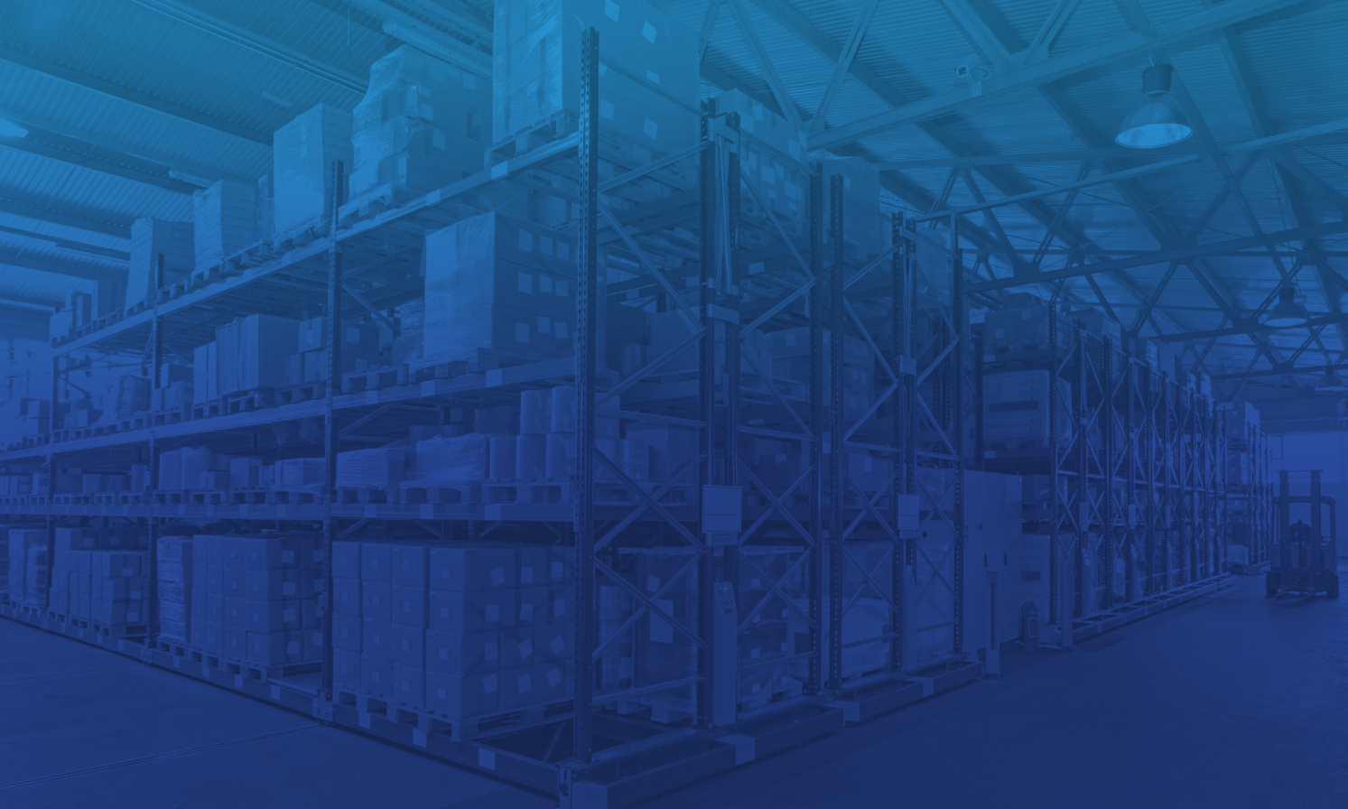
Inventory Management System for Retailers
SmartBridge-VMware Build-A-Thon
Designed and Developed by
PRATIKSHA JAYESH BONGALE

Slide 2
Agenda
1
6
Introduction
System Requirements
2
Overview
7
Results
3
8
Purpose
Advantages and Disadvantages
4
Existing Problems
9
Applications
5
10
Conclusion
Proposed Solution

Slide 3
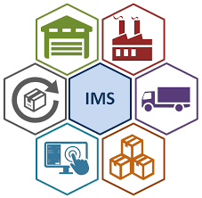
Introduction
The Inventory Management refers to the process of ordering, storing and using a company's inventory.
This includes the management of raw materials, components and finished products, as well as warehousing and processing such items.
A company's inventory is one of its most valuable assets. In retail, manufacturing, food service and other inventory-intensive sectors, a company's inputs and finished products are the core of its business.
A shortage of inventory when and where it's needed can be extremely detrimental.

Slide 4
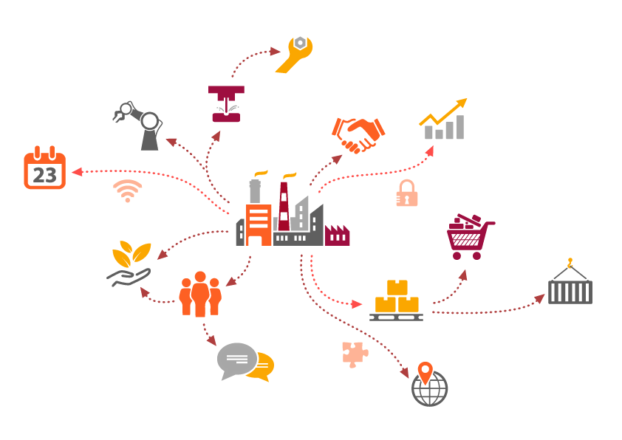
Overview
As a part of your supply chain, inventory management includes aspects such as controlling and overseeing purchases — from suppliers as well as customers — maintaining the storage of stock, controlling the amount of product for sale, and order fulfilment.
Naturally, your company’s precise inventory management meaning will vary based on the types of products you sell and the channels you sell them through.

Slide 5



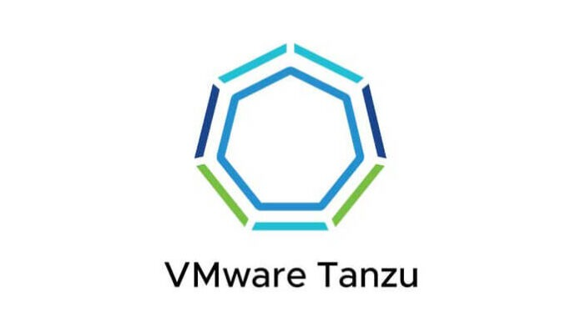
Purpose
This project aims to build an Inventory Management System for retailers to keep track of their inventory by allowing them to insert, update, delete items and much more.
It also sends them an email upon new registration and when the stock empties.
A Flask application is also built for the ease of use.
The app has been mordenized using docker, a docker image has been created and the same has been deployed onto vmware’s tanzu service for everyone to use.

Slide 6
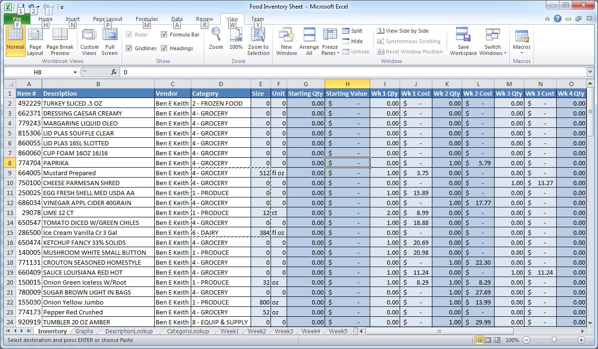
Existing Problems
Small Businesses tend to use Excel sheets for their management that are not so user-friendly and customised.
Large volumes of data is not handled easily using them.
Keeping a humongous amount of data within multiple excel sheets can be taxing!

Slide 7
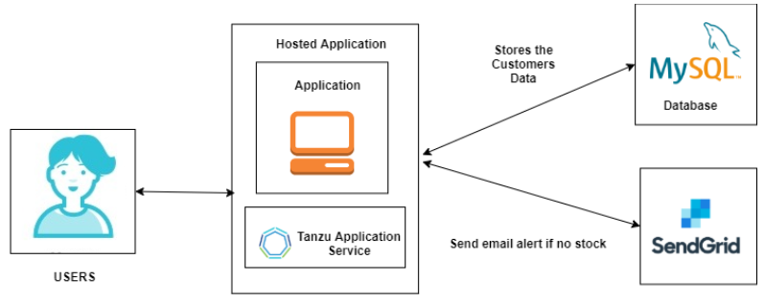
Proposed Solution – Design of the System
Spyder IDE
Python
Flask
HTML
CSS, Bootstrap
Docker
Remote MySQL
VMware Tanzu Service

Slide 8
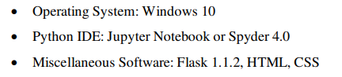
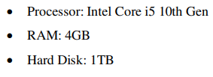
System Requirements
Software Requirements
Hardware Requirements

Slide 9
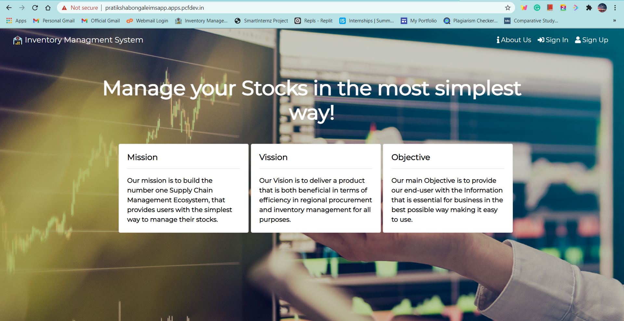
Results – Home page

Slide 10
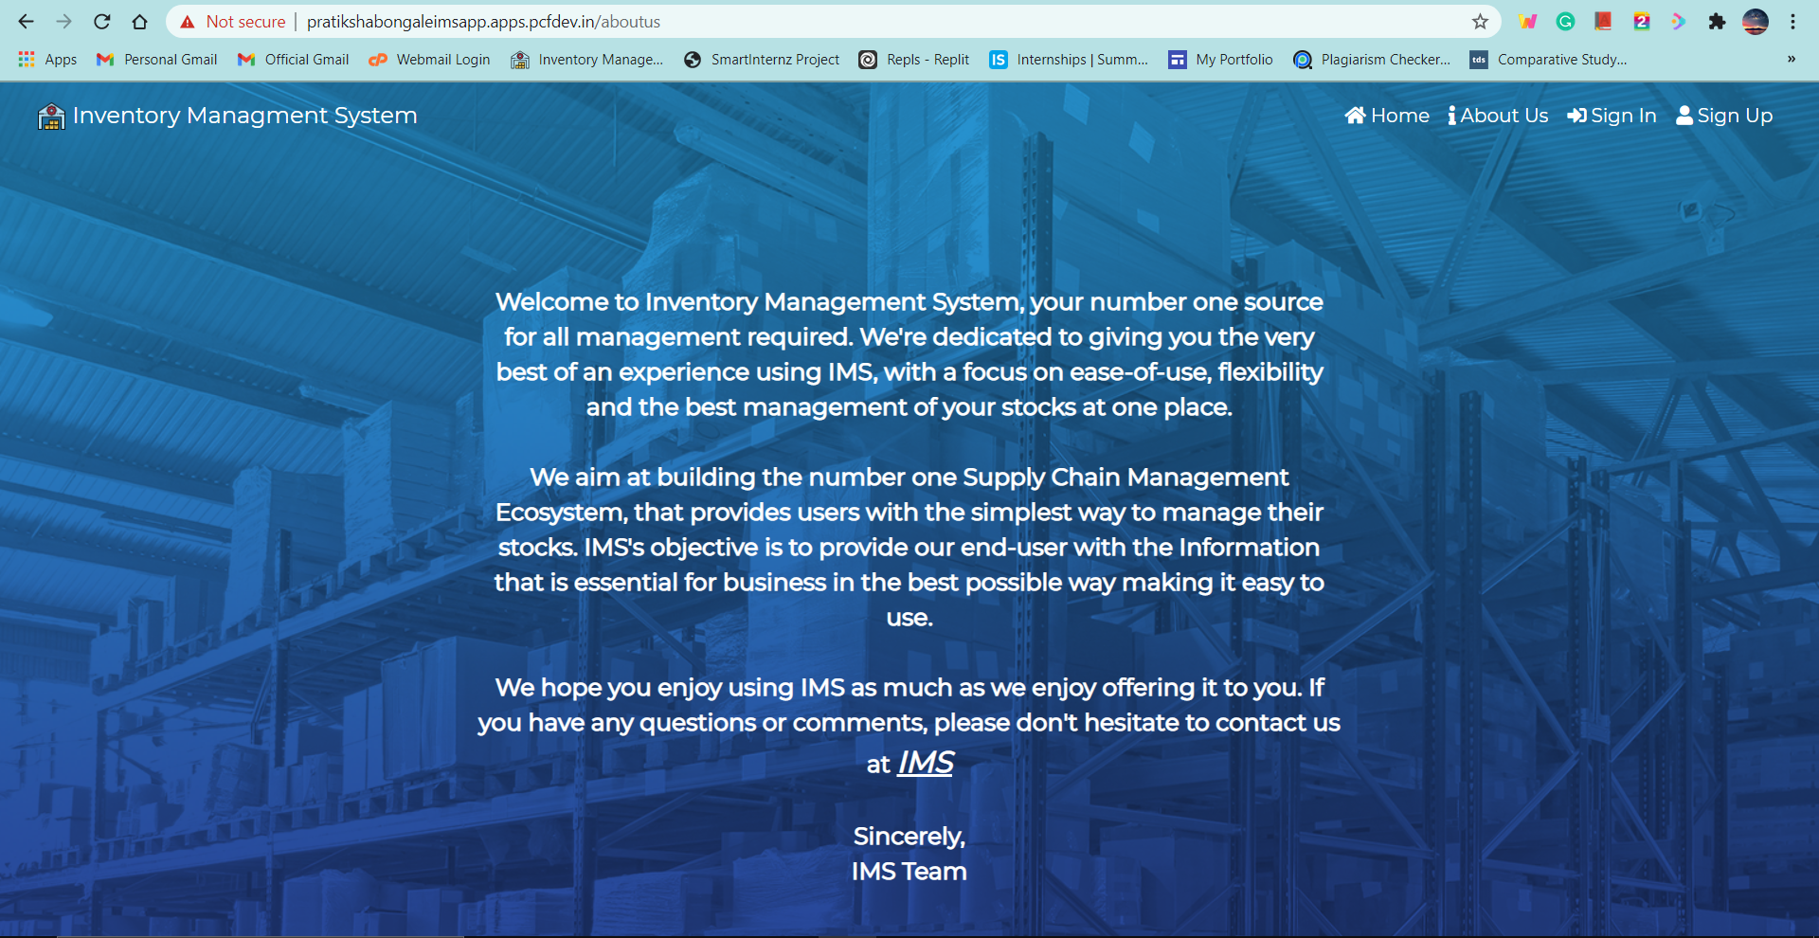
Results – About Us page

Slide 11
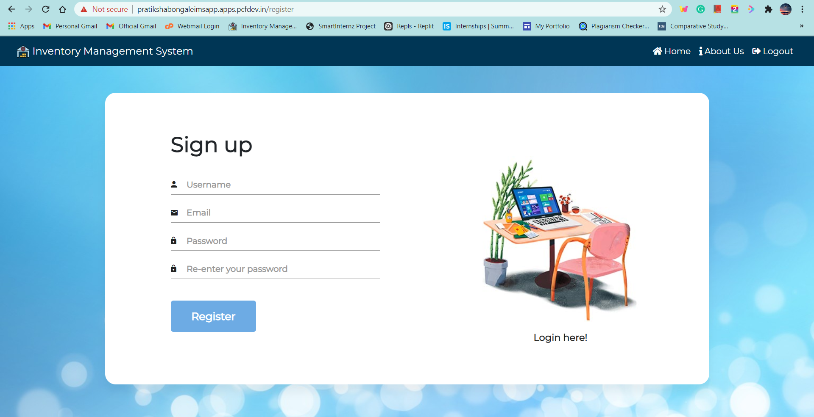
Results – Sign Up page

Slide 12
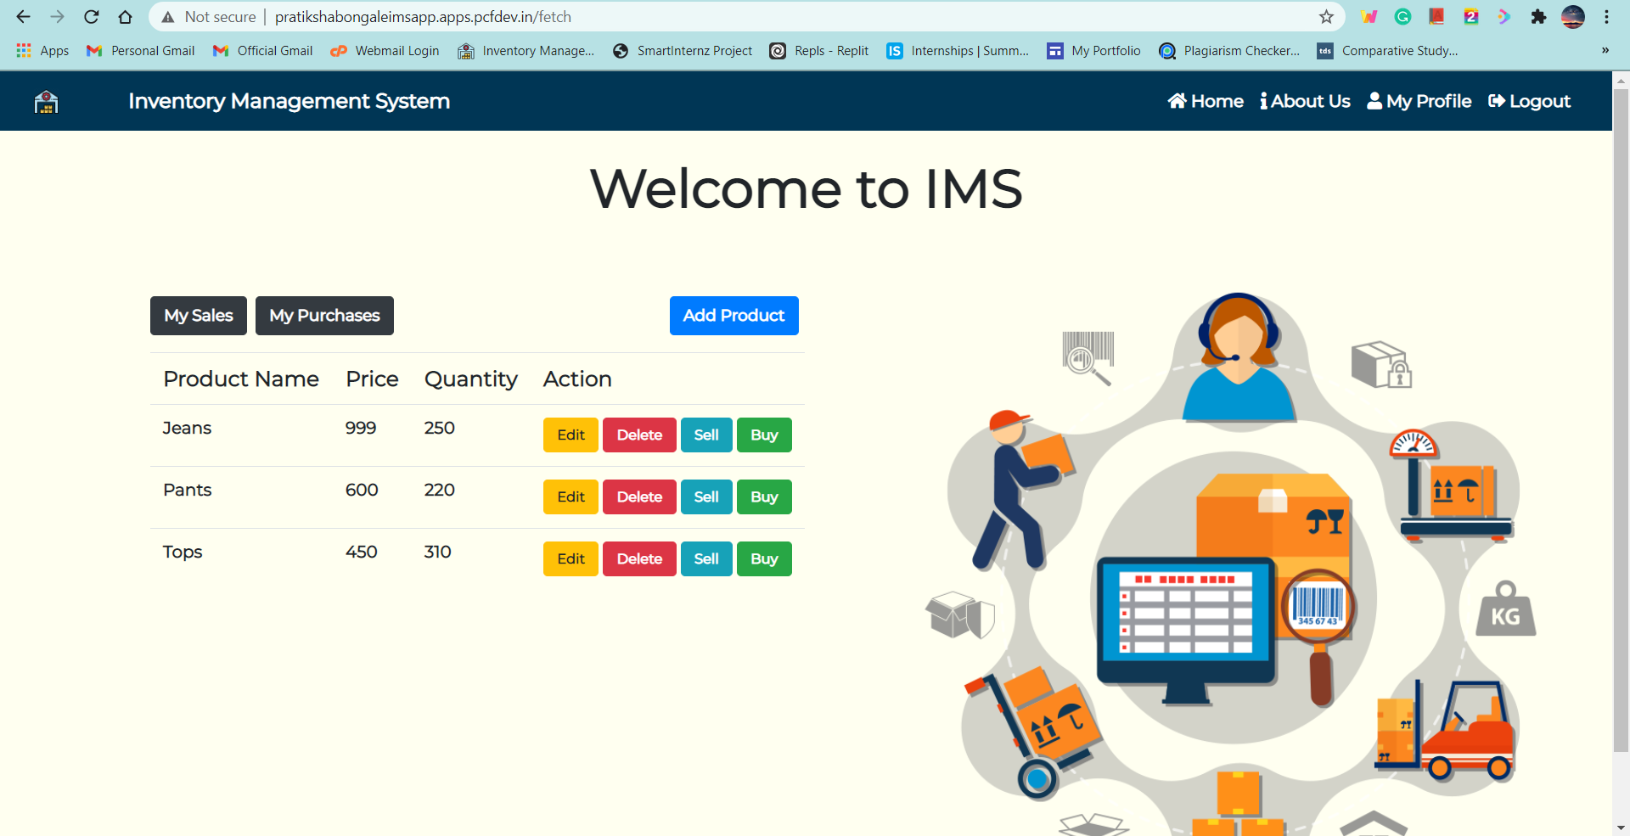
Results – Dashboard

Slide 13
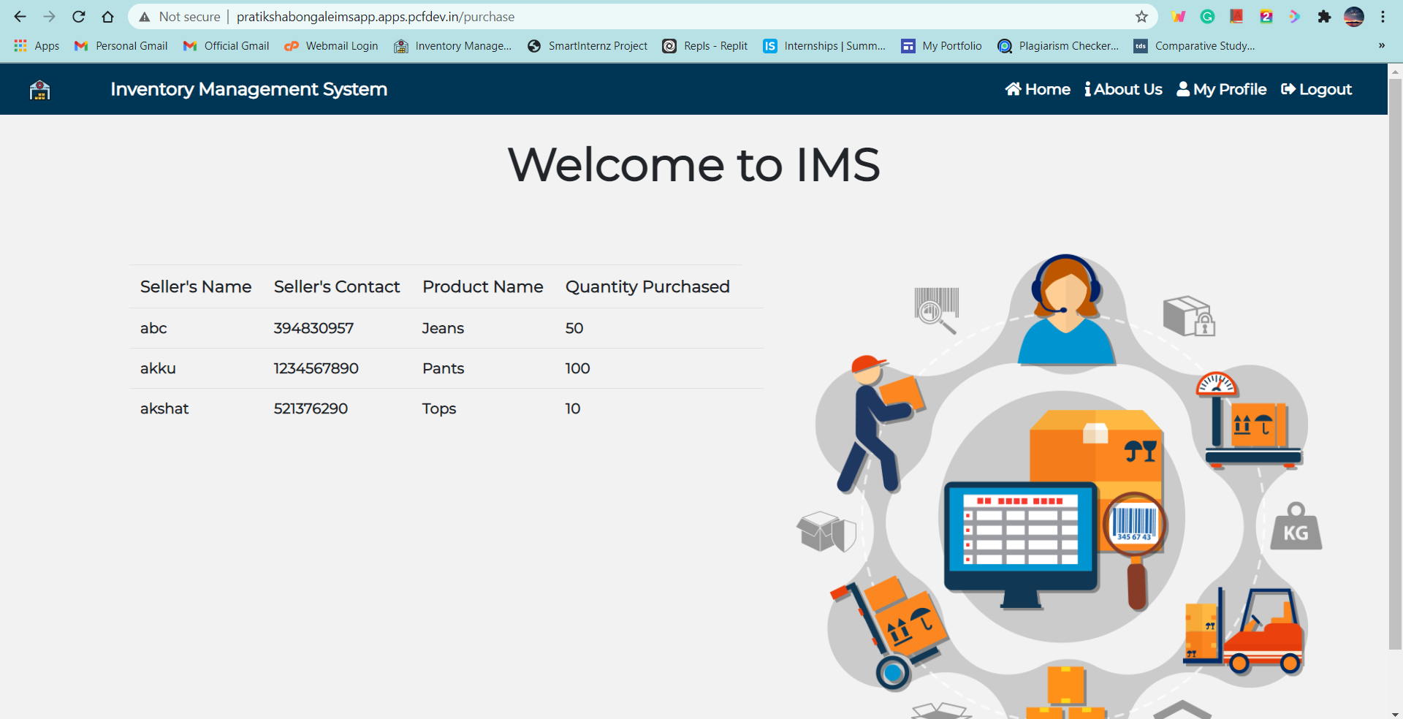
Results – My Purchases

Slide 14
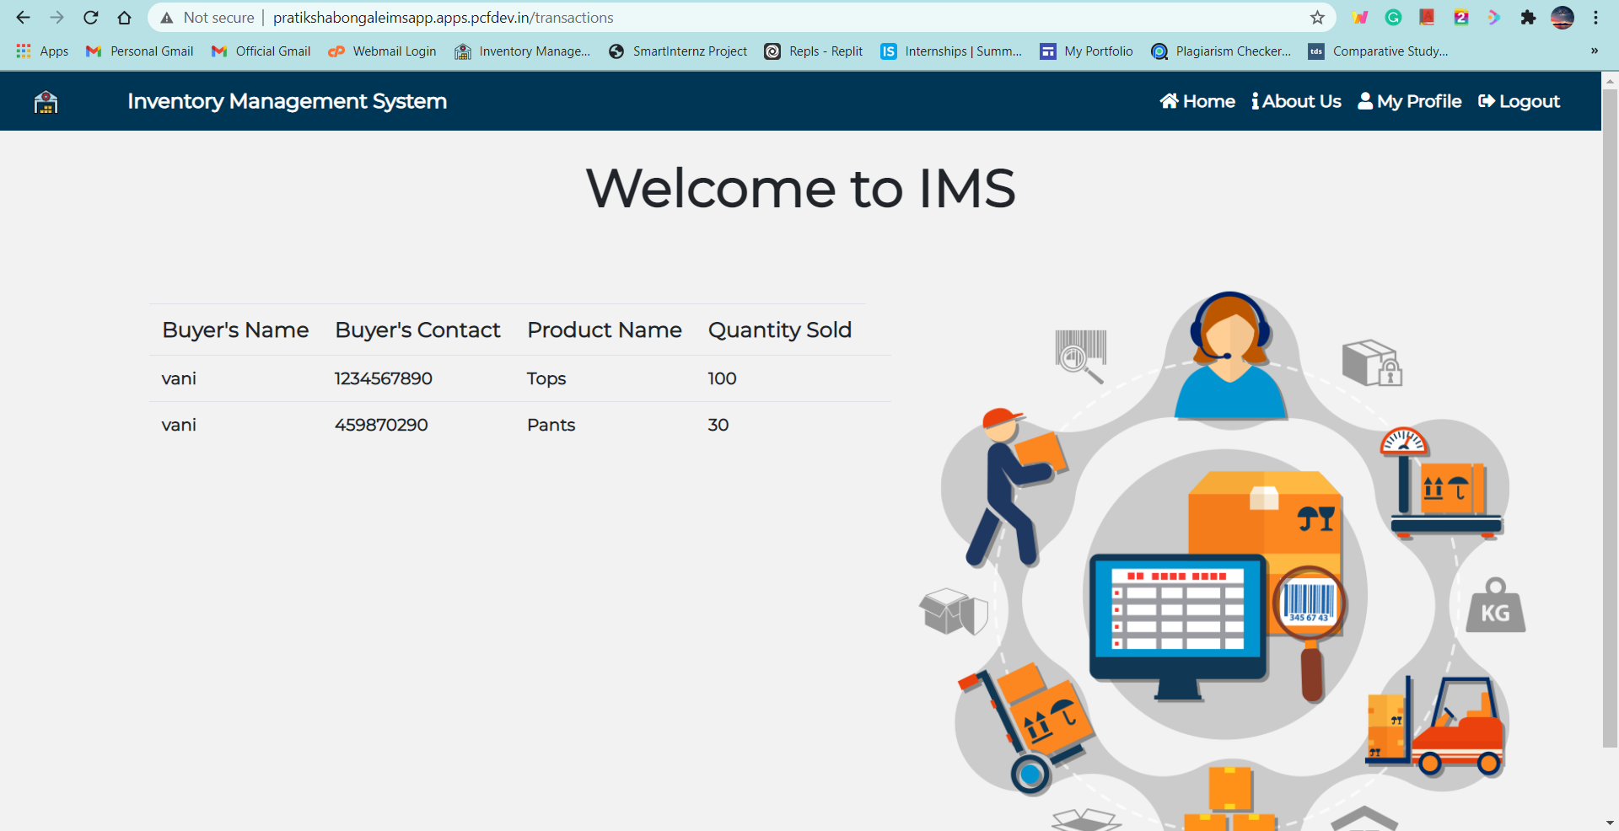
Results – My Sales

Slide 15
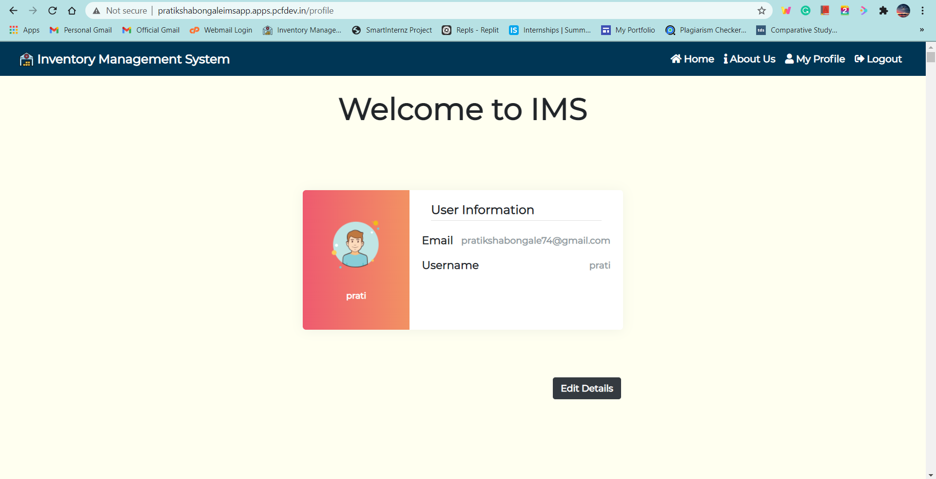
Results – My Profile

Slide 16
Advantages and Disadvantages
Advantages:
Easy and simple User Interface for Retailers to keep track of al their inventory in one place.
It is widely used for managing inventory in almost all the sectors that deal with customers.
It is composed using the HTML, CSS, Bootstrap and Python for the web usage in real time.
It can work in real time.
Disadvantages:
Needs manual data enterer for maintaining the data.

Slide 17
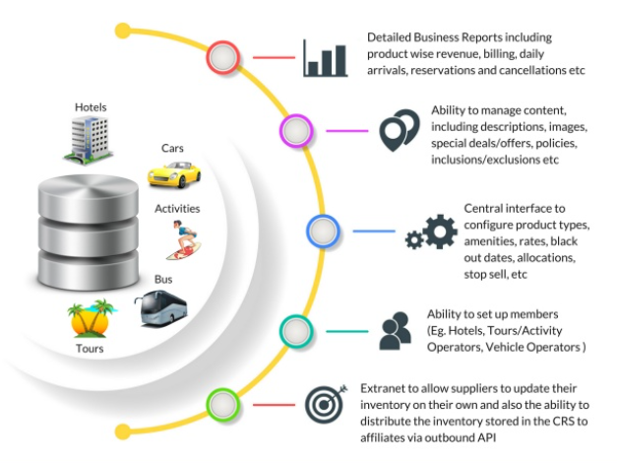
Applications of IMS

Slide 18
Conclusion
In this system we try to build an Inventory Management System for retailers to keep track of their inventory by allowing them to insert, update, delete items and much more.
It also sends them an email upon new registration and when the stock empties.
A Flask application is also built for the ease of use. The app has been mordenized using docker, a docker image has been created and the same has been deployed onto vmware’s tanzu service for everyone to use.

Slide 19


